Slide 1
Ship Evaluation: Bet Performer
Group 7
Group Members:
Apurva Tawde
Khanjan Patel
Parika Gupta
Vandana Agrawal

Slide 2
Ship Category
(Merchant Ships)
Tanker
Dry Bulk Ship
Handysize
Handymax
Panamax
Capesize
Container
Global Maritime Industry &
Ship Categorization
Raw Materials
Manf. goods
Liquids
less than 10,000 DWT
10,000 to 30,000 DWT
30,000 to 50,000
DWT
Bet Performer
Life 25 years
up to 200,000 DWT or more

Slide 3
Problem Statement
Basil Karatzas received New Clients Request
Karatzas
Reviewed ‘Ship for sales’ & found
“Bet Performer”
Make an Offer
Client wanted assistance
with identifying an appropriate ship,
assessing its value and making an offer
To estimate ships values based on certain parameters

Slide 4

Specification: Bet Performer
Build in 1997 in Japan, Age:11
Built by Nihon Kōkan Kabushiki-Kaisha
Dead Weight Ton (DWT) : 1,72,000
Burmeister & Wain (B&W) 6S70 MC engine
Prior sold at $70 million
Sold 2 years as “Mineral Poterne”

Slide 5
The Market Approach
Income Approach
Cost Approach
Approach

Slide 6
The Market Approach
Parameters Considered
Age at Sale
Years
Baltic Dry Capesize Index
Sale Price $
11
12479
Dead-Weight Tons (000)
1,72,000

Slide 7
Our Estimate For
“Bet Performer”
125.82 Million $

Slide 8

Range To Make Offer
132.76 Million $
125.82 Million $
125.82 Million $

Slide 9
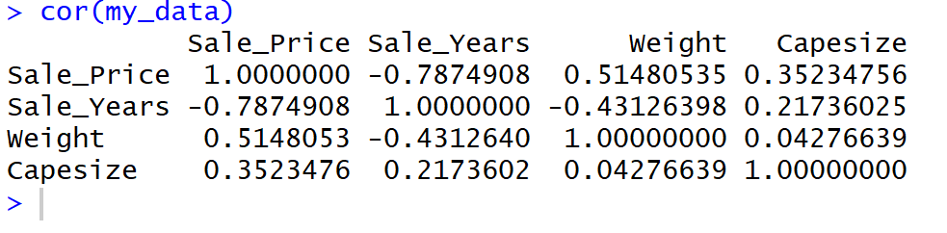
Backup slides
Finding Correlation in the data

Slide 10
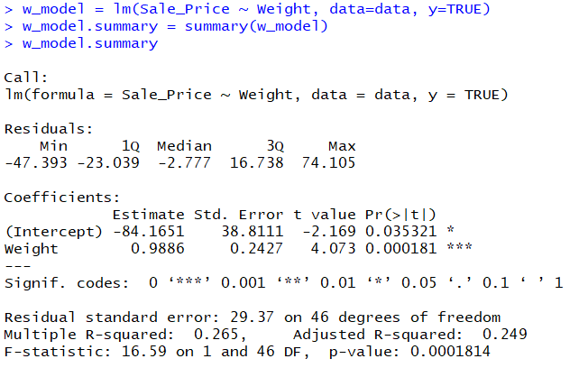
Backup slides
Model:
Sale_Price ~ Weight

Slide 11
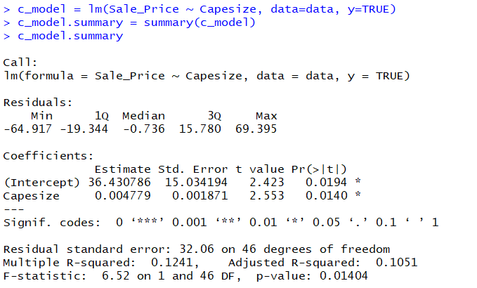
Backup slides
Model:
Sale_Price ~ Capesize

Slide 12
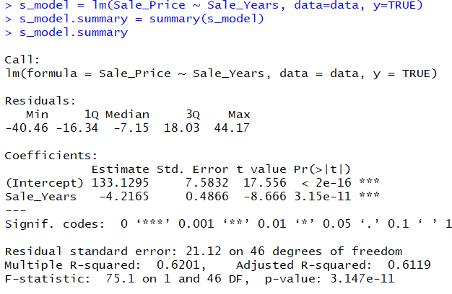
Backup slides
Model:
Sale_Price ~ Sale_Year

Slide 13
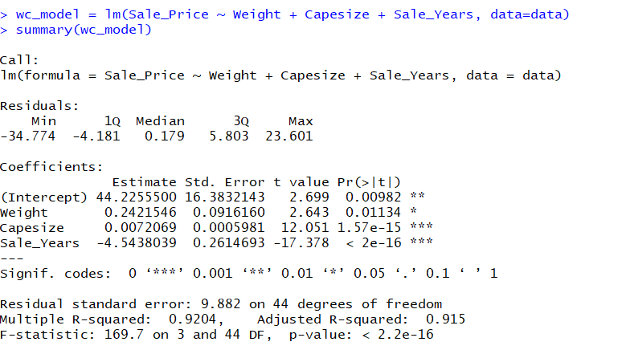
Backup slides
Model:
Sale_Price ~ Weight + Capesize + Sale_Year

Slide 14
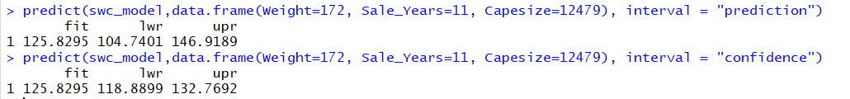
Backup slides
Finding the Point Estimation and Confidence Interval

